Slide 1
XML: DTD AND XML SCHEMA

Slide 2
XML
Extensible Markup Language (XML) is similar to HTML.
Designed to represent data.
Unlike HTML, XML does not prescribe the set of tags allowed, and the set may be chosen as needed by each application.
This feature is the key to XML’s major role in data representation and exchange, whereas HTML is used primarily for document formatting.

Slide 3
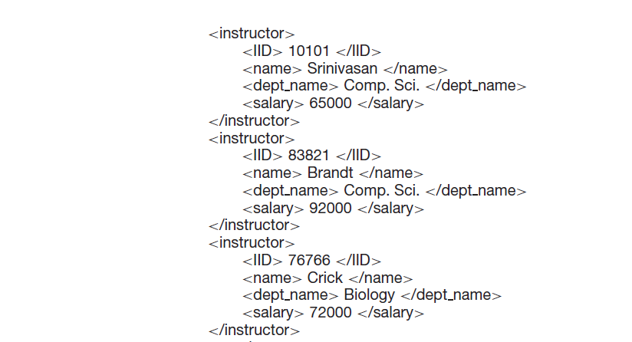
XML

Slide 4
ADVANTAGES
Compared to storage of data in a relational database, the XML representation may be inefficient, since tag names are repeated throughout the document.
However, in spite of this disadvantage, an XML representation has significant advantages when it is used to exchange data between organizations, and for storing complex structured information in files.
First, the presence of the tags makes the message self-documenting
Second, the format of the document is not rigid.
Third, XML allows nested structures.
Finally, since the XML format is widely accepted, a wide variety of tools are available to assist in its processing, including programming language APIs to create and to read XML data, browser software, and database tools.

Slide 5
XML Document Schema
By default, XML documents can be created without any associated schema: an element may then have any sub-element or attribute.
While such freedom may occasionally be acceptable given the self-describing nature of the data format, it is not generally useful when XML documents must be processed automatically as part of an application, or even when large amounts of related data are to be formatted in XML.
The Document Type Definition, as well as its more recently defined replacement, XML Schema.

Slide 6
DTD
The document type definition (DTD) is an optional part of an XML document. The main purpose of a DTD is much like that of a schema: to constrain and type the information present in the document.
However, the DTD does not in fact constrain types in the sense of basic types like integer or string. Instead, it constrains only the appearance of subelements and attributes within an element.
Primarily a list of rules for what pattern of subelements may appear within an element.
Each declaration is in the form of a regular expression for the subelements of an element.

Slide 7
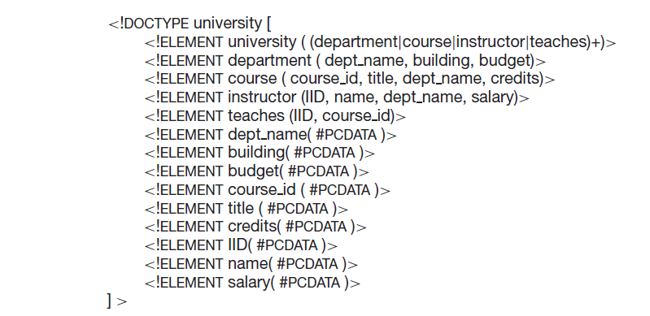
DTD

Slide 8
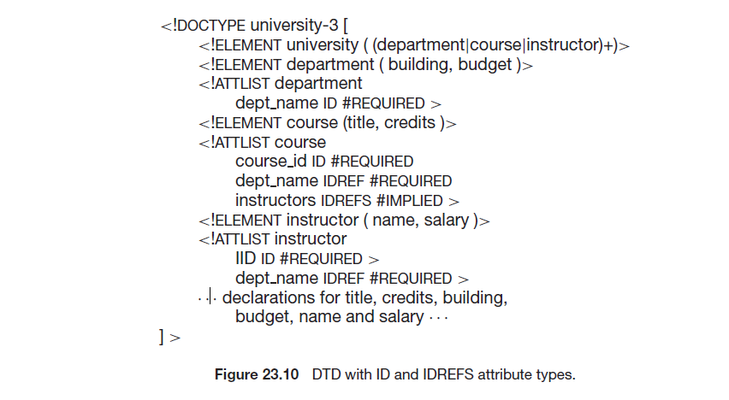
Defining Attributes
The keyword #PCDATA indicates text data;
The allowable attributes for each element are also declared in the DTD. Unlike sub elements, no order is imposed on attributes.

Slide 9
Defining Attributes
An attribute of type ID provides a unique identifier for the element; a value that occurs in an ID attribute of an element must not occur in any other element in the same document.
At most one attribute of an element is permitted to be of type ID.
An attribute of type IDREF is a reference to an element; the attribute must contain a value that appears in the ID attribute of some element in the document.
The type IDREFS allows a list of references, separated by spaces.

Slide 10
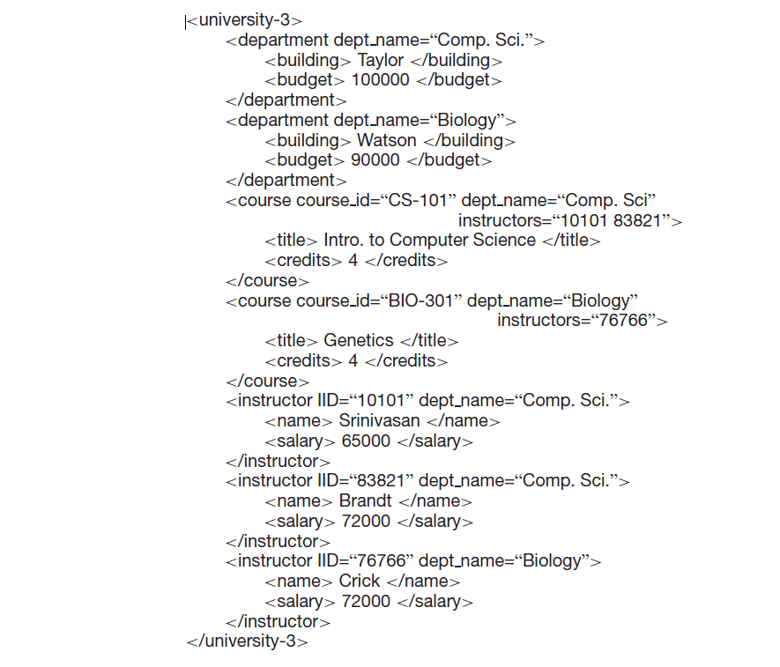
Defining Attributes

Slide 11
Disadvantages
Individual text elements and attributes cannot be typed further. For instance,he element balance cannot be constrained to be a positive number. The lack of such constraints is problematic for data processing and exchange applications, which must then contain code to verify the types of elements and attributes.
It is difficult to use the DTD mechanism to specify unordered sets of subelements. Order is seldom important for data exchange (unlike document layout, where it is crucial). While the combination of alternation (the | operation)and the ∗ or the + operation permits the specification of unordered collections of tags, it is much more difficult to specify that each tagmay only appear once.

Slide 12
Disadvantages
There is a lack of typing in IDs and IDREFSs. Thus, there is no way to specify the type of element to which an IDREF or IDREFS attribute should refer. As a result, the DTD in Figure 23.10 does not prevent the “dept name” attribute of a course element from referring to other courses, even though this makes no sense.

Slide 13
XML Schema
An effort to redress the deficiencies of the DTD mechanism resulted in the development of a more sophisticated schema language, XML Schema.
XML Schema defines a number of built-in types such as string, integer, decimal date, and boolean. In addition, it allows user-defined types; these may be simple types with added restrictions, or complex types constructed using constructors such as complexType and sequence

Slide 14
XML Schema
To distinguish built-in XML Schema tags from your custom-defined tags, we use a namespace prefix, usually xs:

Slide 15
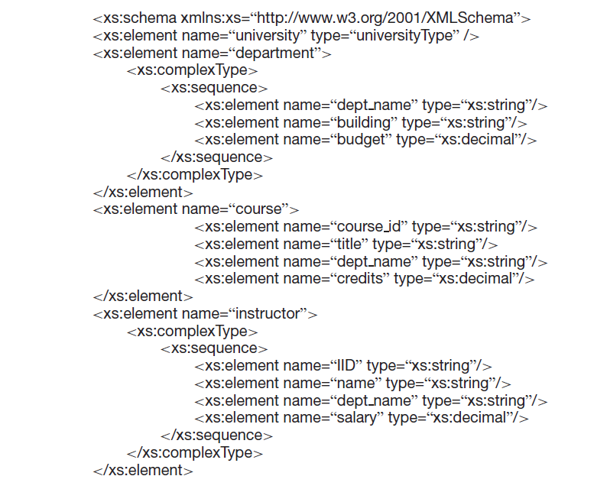

Slide 16
XML Schema
The type of department is defined to be a complex type, which is further specified to consist of a sequence of elements dept name, building, and budget.
Any type that has either attributes or nested subelements must be specified to be a complex type.

Slide 17
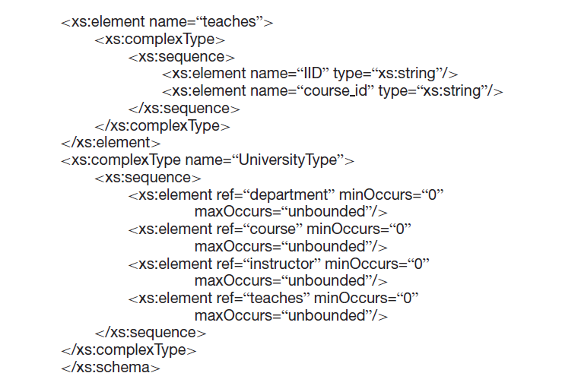

Slide 18
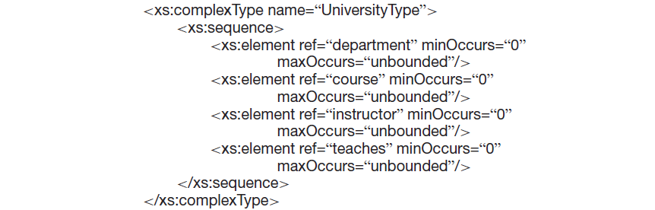
XML Schema
We can use the xs:complexType element to create named complex types

Slide 19
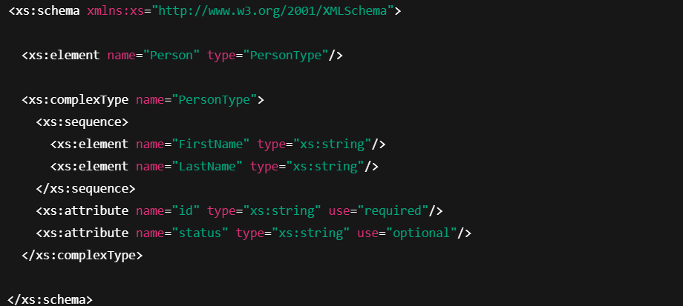
XML Schema
Attributes are specified using the xs:attribute tag.

Slide 20
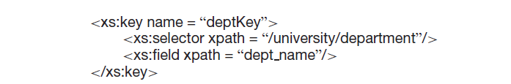
XML Schema
XML Schema allows the specification of keys and key references, corresponding to the primary-key and foreign-key definition in SQL
.

Slide 21
XML Schema
Correspondingly a foreign-key constraint from course to department may be defined as follows using <xs:keyref> :.
<xs:keyref name=“courseDeptForeignKey" refer="deptKey">
<xs:selector xpath=" /university/course”/"/>
<xs:field xpath="dept_name"/>
</xs:keyref>
refer attribute contains a value that should be the primary key that is being referred.

Slide 22
Advantages of XML Schema over DTD
It allows types to be restricted to create specialized types, for instance by specifying minimum and maximum values.
It allows complex types to be extended by using a form of inheritance.

